Slide 1
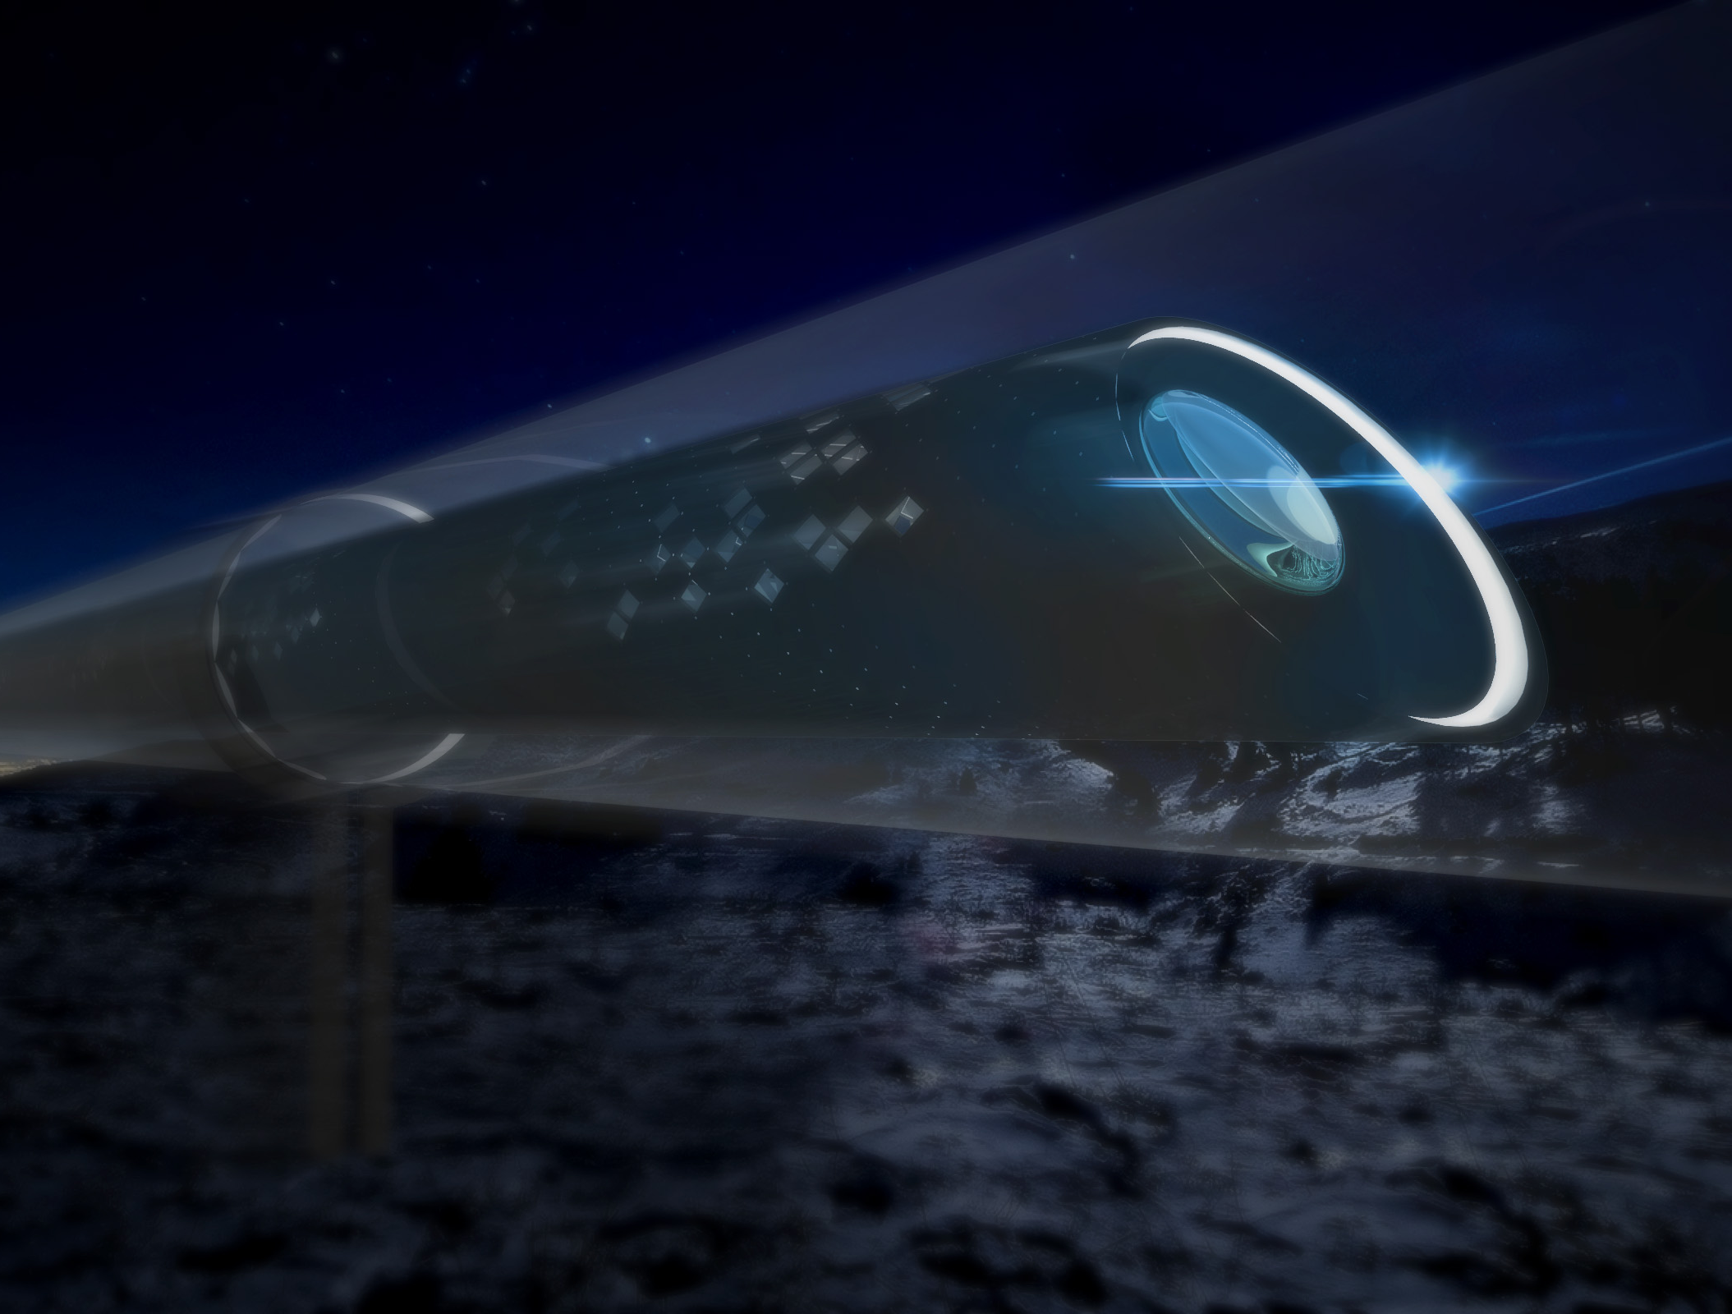


TRANSPORTATION — INNOVATED.
SpaceX Hyperloop Technical Presentation University of Waterloo Hyperloop Team
University of Waterloo—Hyperloop Final Design Package | 1

Slide 2
HYPERLOOP VIDEO
University of Waterloo—Hyperloop Final Design Package | 2

Slide 3
TEAM INTRODUCTION
Technical Design
Drive Train
Exterior Design
Levitation
Pod Body Design
Embedded System
Braking
Thermal Analysis
Interior & Vibration
Battery
Industrial Design
Safety
Management
University of Waterloo—Hyperloop Final Design Package | 3

Slide 4
"A designer knows he has achieved perfection not when there is nothing left to add, but when there is nothing left to take away.“
--- Antoine de Saint Exupery
University of Waterloo—Hyperloop Final Design Package | 4

Slide 5
DESIGN PHILOSOPHY
Functional
Achievable
Simple
Testable
University of Waterloo—Hyperloop Final Design Package | 5

Slide 6
GENERAL POD SUMMARY (GONE?)
Weight (total only)
Power requirement
Max speed
Dimensions
Method of levitation/propulsion
University of Waterloo—Hyperloop Final Design Package | 6

Slide 7
700 kg
Approximately 1500lbs total weight
University of Waterloo—Hyperloop Final Design Package | 7

Slide 8
1.5 kW
Required power, mainly for controllers
~2 hp
University of Waterloo—Hyperloop Final Design Package | 8

Slide 9
335 km/hr
Top Speed
equivalent to 208mph (93m/s)
University of Waterloo—Hyperloop Final Design Package | 9

Slide 10
$48,000
Estimated Construction Cost including 30% contingency
University of Waterloo—Hyperloop Final Design Package | 10

Slide 11
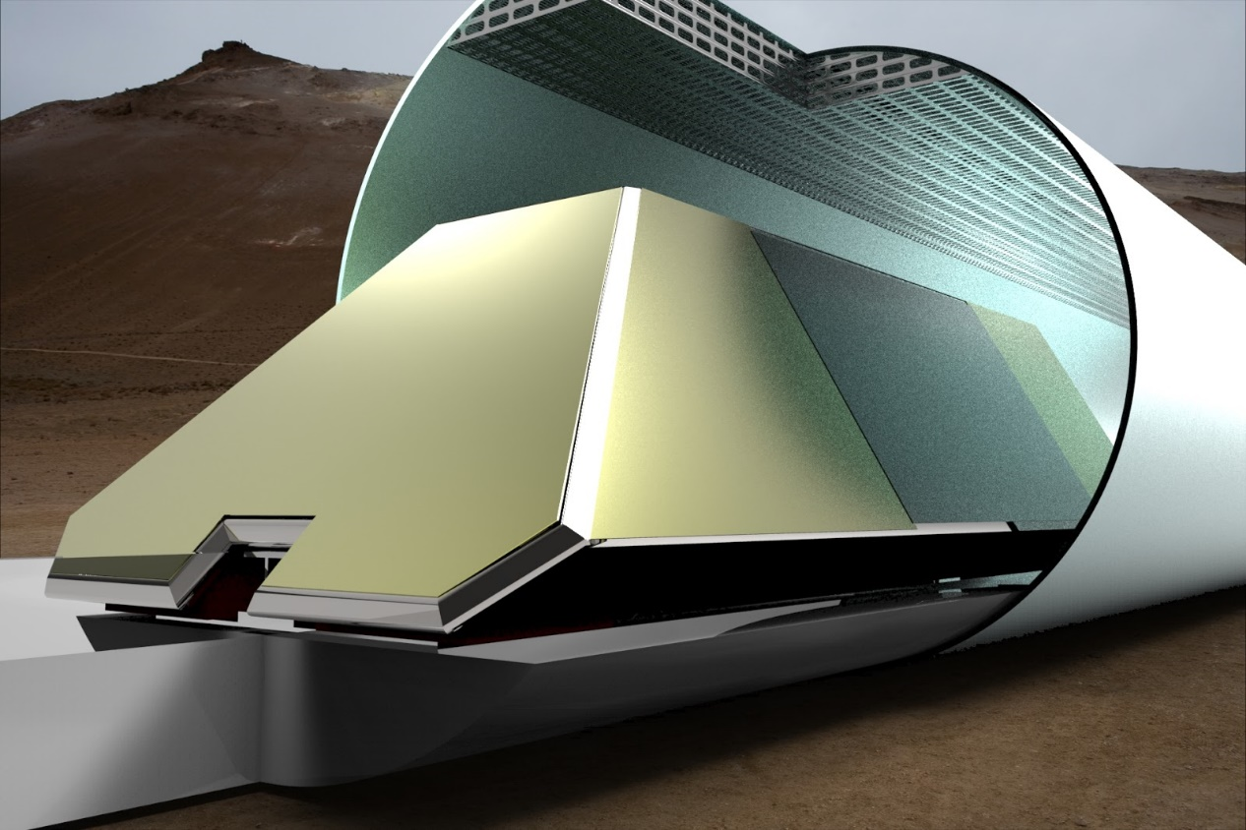
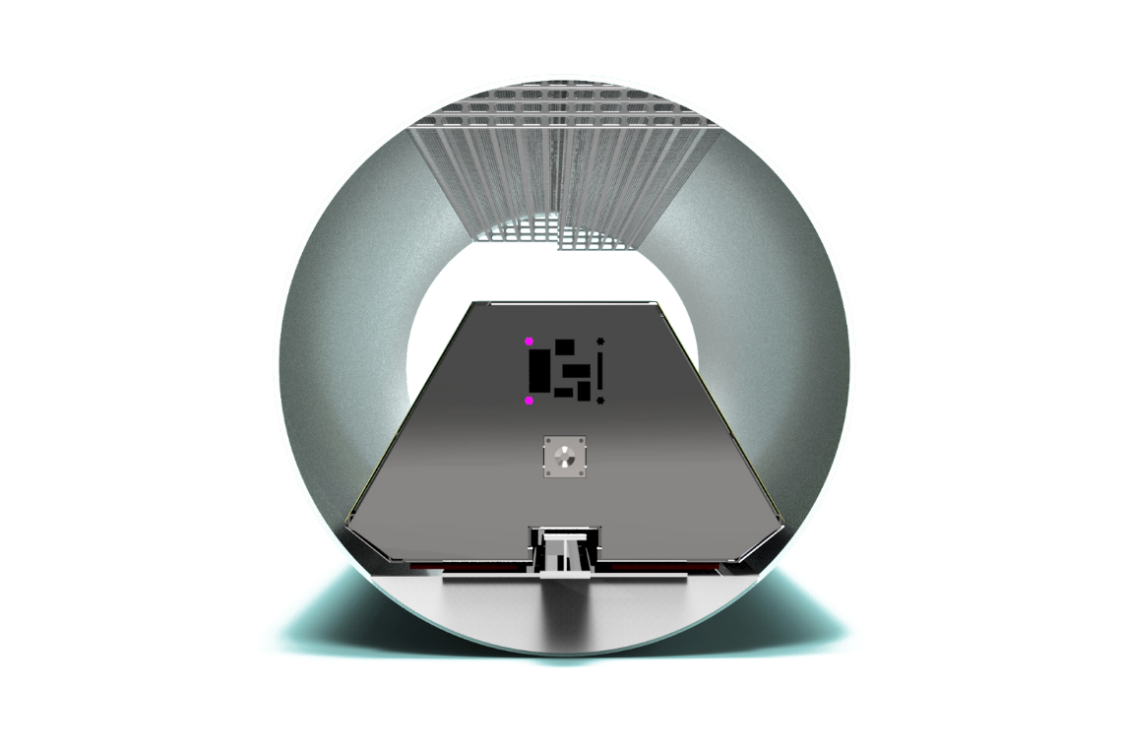
POD DIMENSIONS
1320 mm wide (52”)
850 mm high (34”)
3100 mm long (122”)
University of Waterloo—Hyperloop Final Design Package | 11

Slide 12
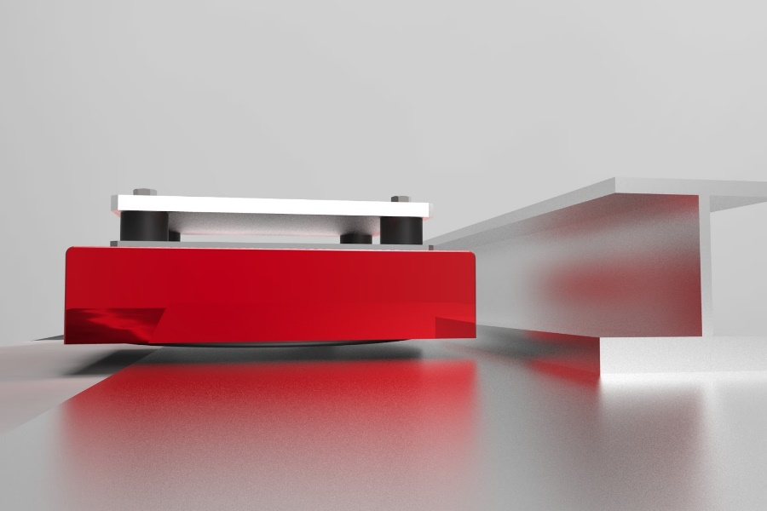
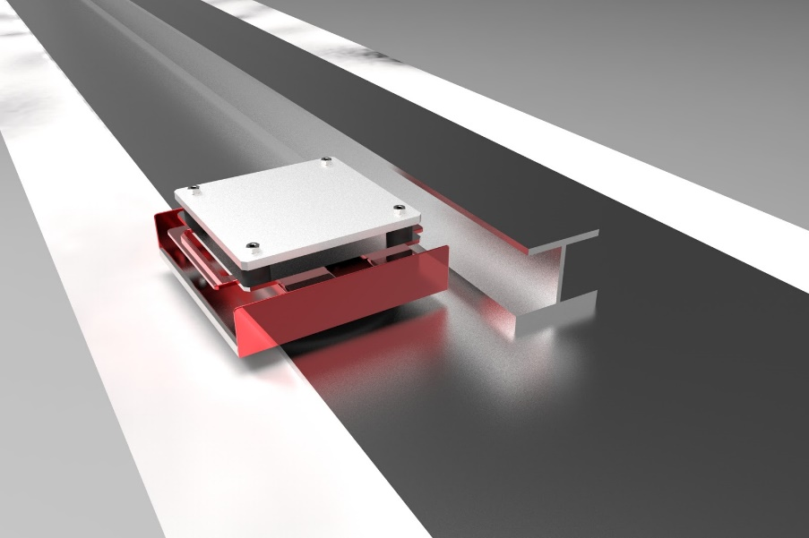
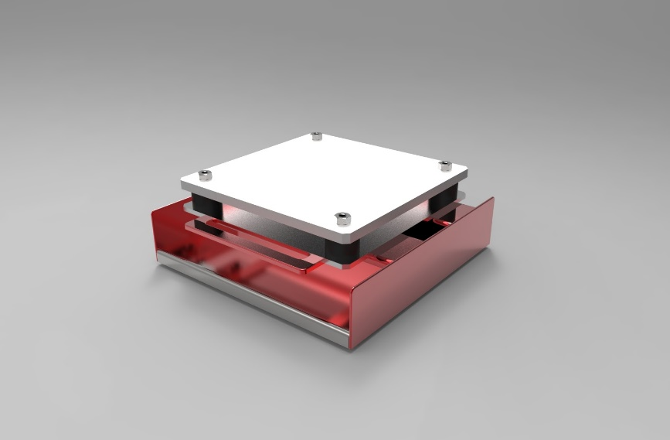
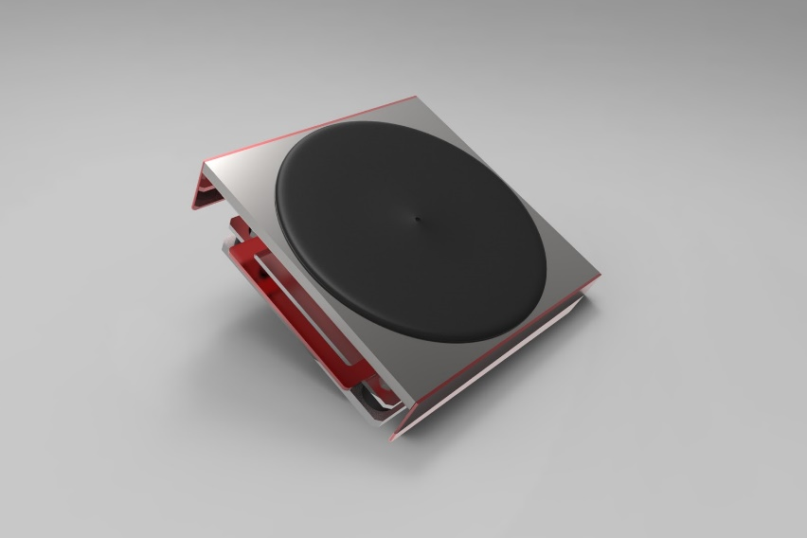
LEVITATION
University of Waterloo—Hyperloop Final Design Package | 12

Slide 13
AIR STORAGE
University of Waterloo—Hyperloop Final Design Package | 13

Slide 14
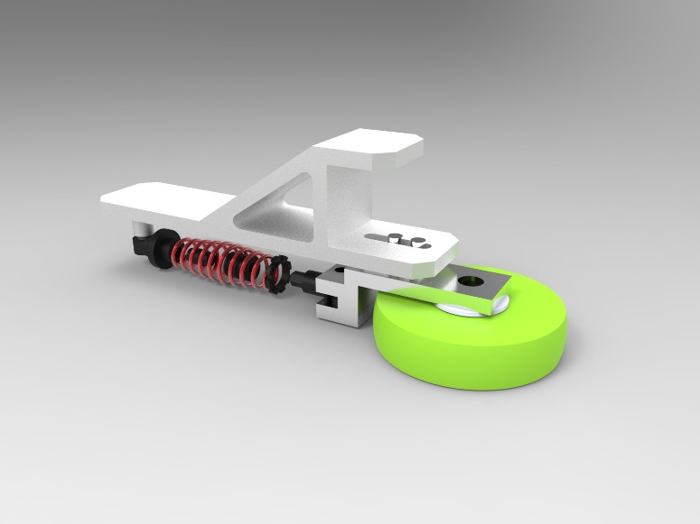
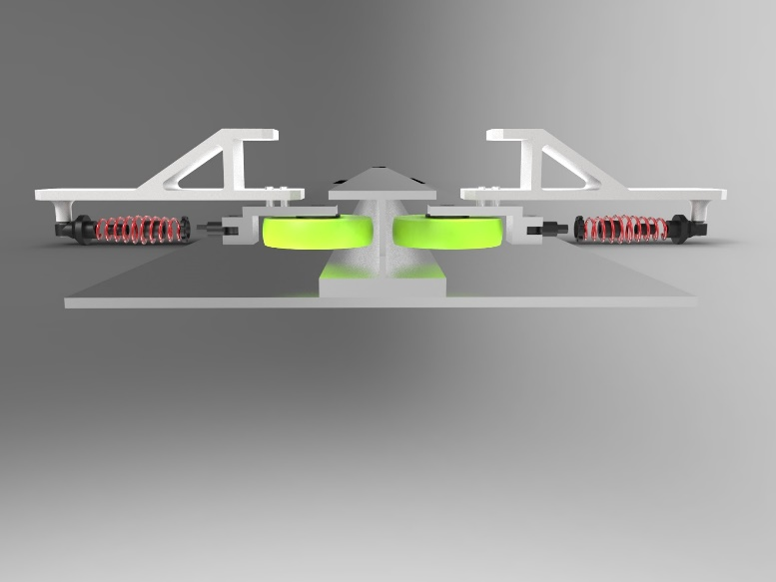
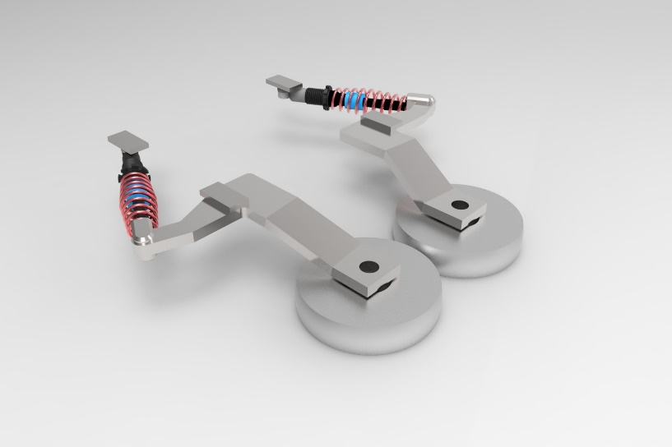
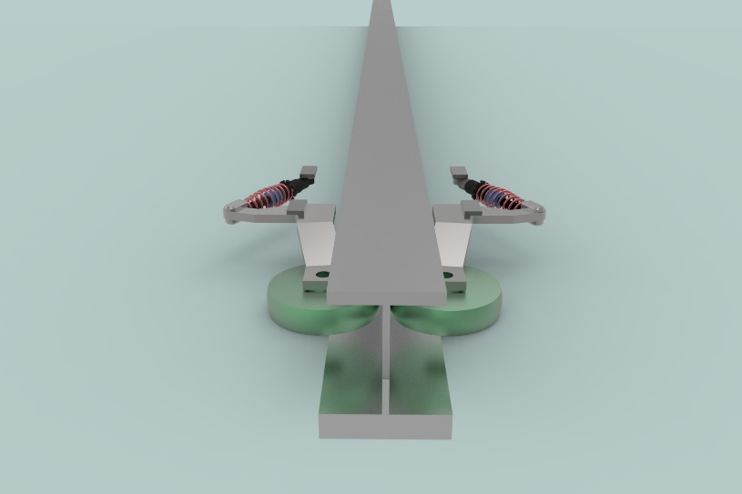
LATERAL CONTROL
University of Waterloo—Hyperloop Final Design Package | 14

Slide 15
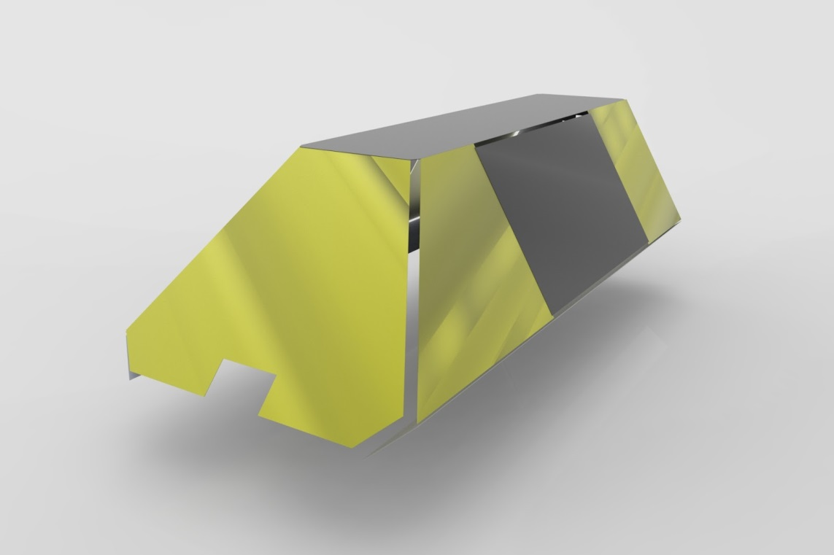
POD BODY
Al-505
12 ga. = 2mm
Low Cost
No pressure boundary
University of Waterloo—Hyperloop Final Design Package | 15

Slide 16
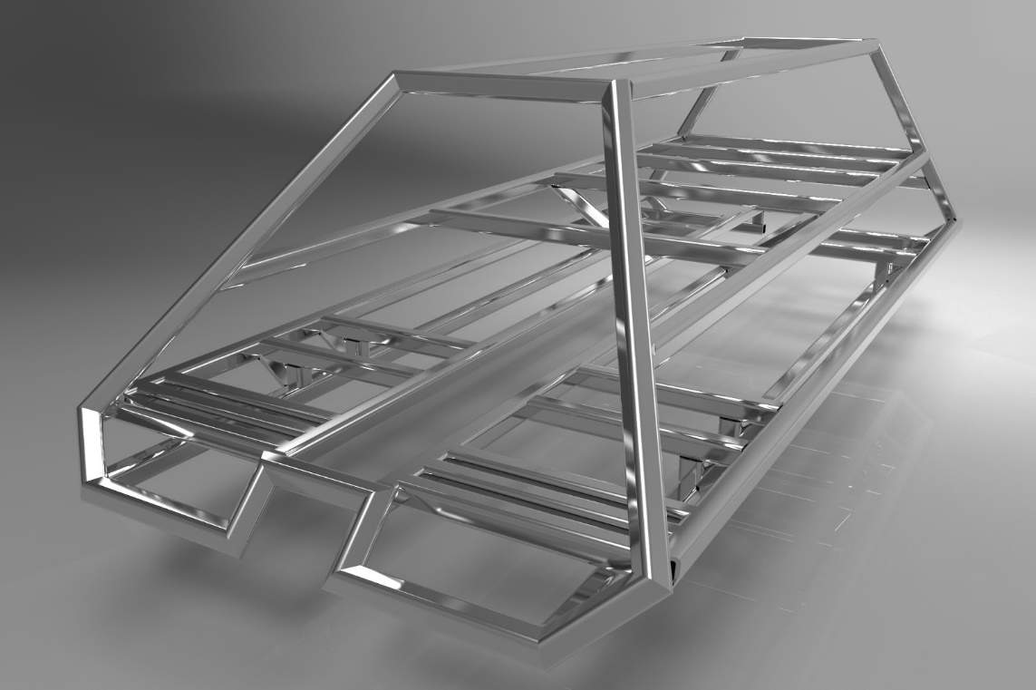

INTERNAL FRAME
Al 6061
HSS 2”x2”x⅛”
Ease of manufacture
University of Waterloo—Hyperloop Final Design Package | 16

Slide 17
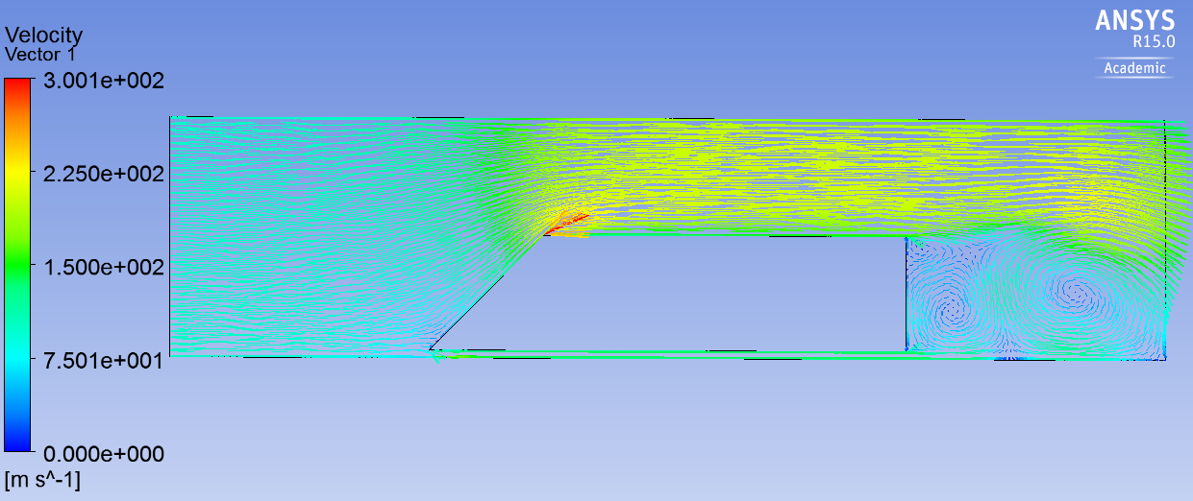
POD BODY - AERODYNAMICS
CD = 1.42
Kantrowitz limit
max area 1.92 m2 > 0.77 m²
F_{D} = F_{Skin} + F_{Pressure} = 1.9 + 8.5 = 10.4 N
University of Waterloo—Hyperloop Final Design Package | 17

Slide 18
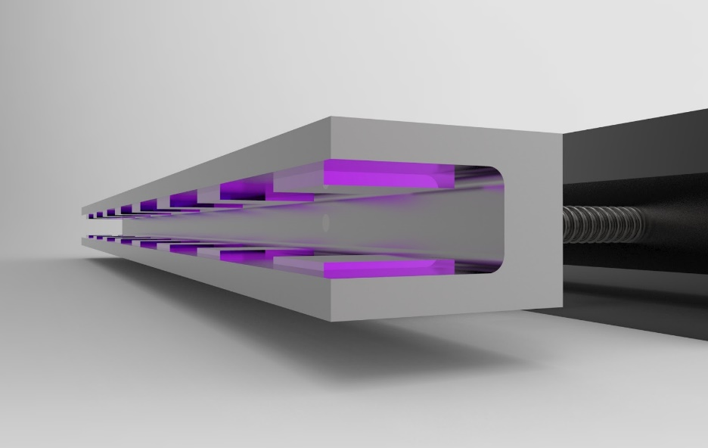
BRAKING: EDDY CURRENT
100 m/s to 60 m/s = 46% KE remaining
University of Waterloo—Hyperloop Final Design Package | 18

Slide 19
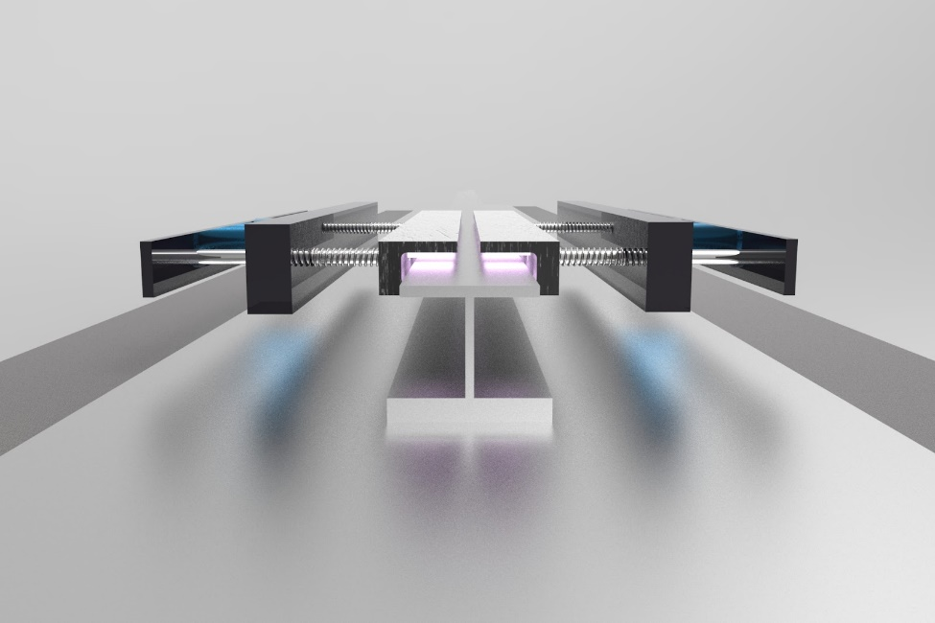
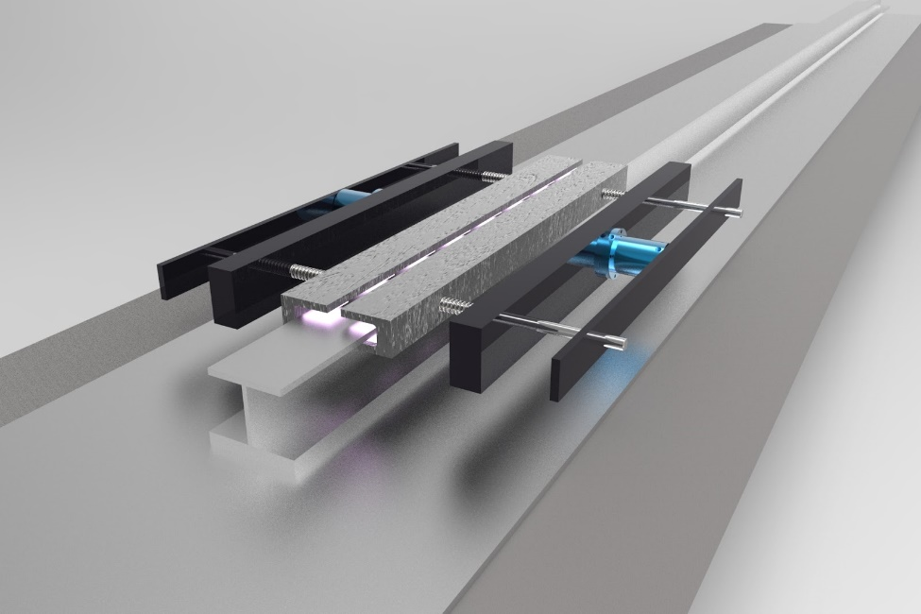
BRAKING: EDDY CURRENT
48 neodymium permanent magnets
Energy fully removed
Fail safe
University of Waterloo—Hyperloop Final Design Package | 19

Slide 20
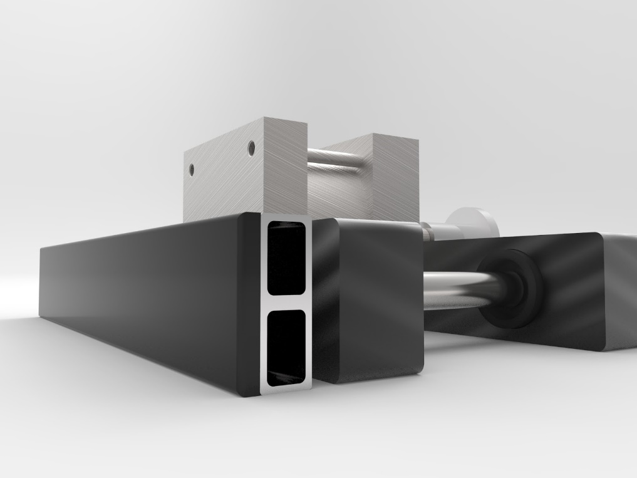
BRAKING: FRICTION
University of Waterloo—Hyperloop Final Design Package | 20

Slide 21
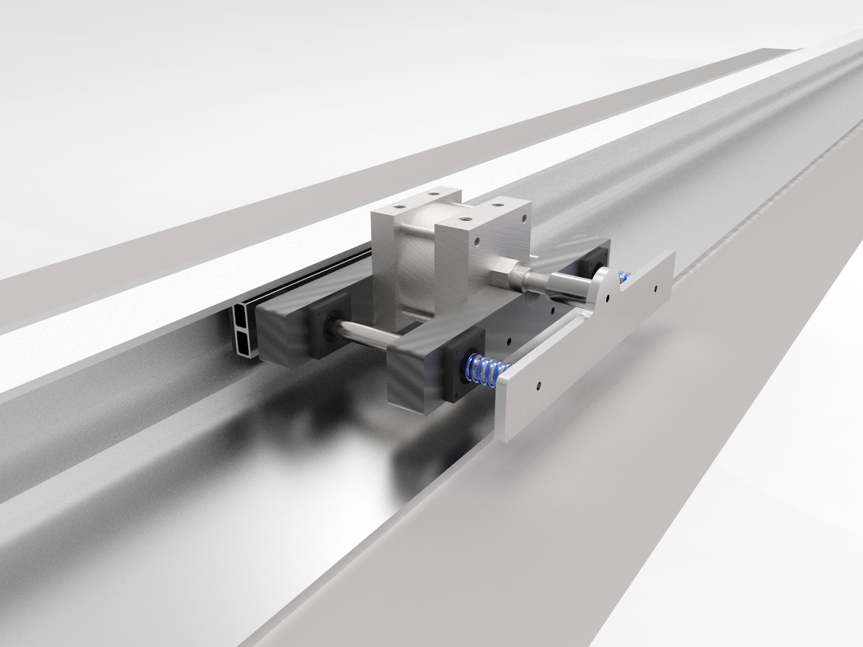
BRAKING: FRICTION
University of Waterloo—Hyperloop Final Design Package | 21

Slide 22
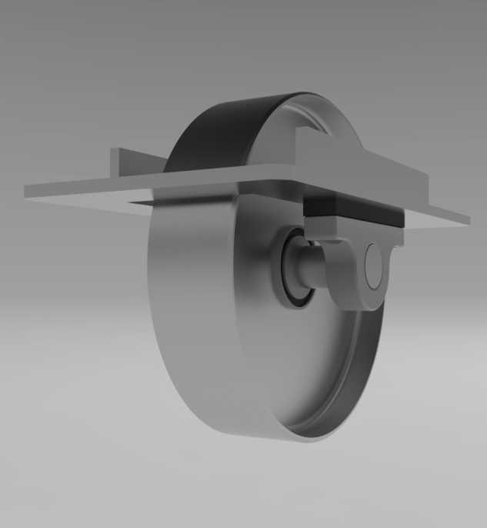
DRIVE TRAIN – IDLER WHEELS
Usage Scenario
Recovery Mode( Protect Air Casters )
Drive Mode ( Lower power needed to maintain motion )
Design
High Speed ( 10,000 RPM )
High Load ( 400 lbs ea. )
Vibration Dampening( Up to 26Hz )
University of Waterloo—Hyperloop Final Design Package | 22

Slide 23
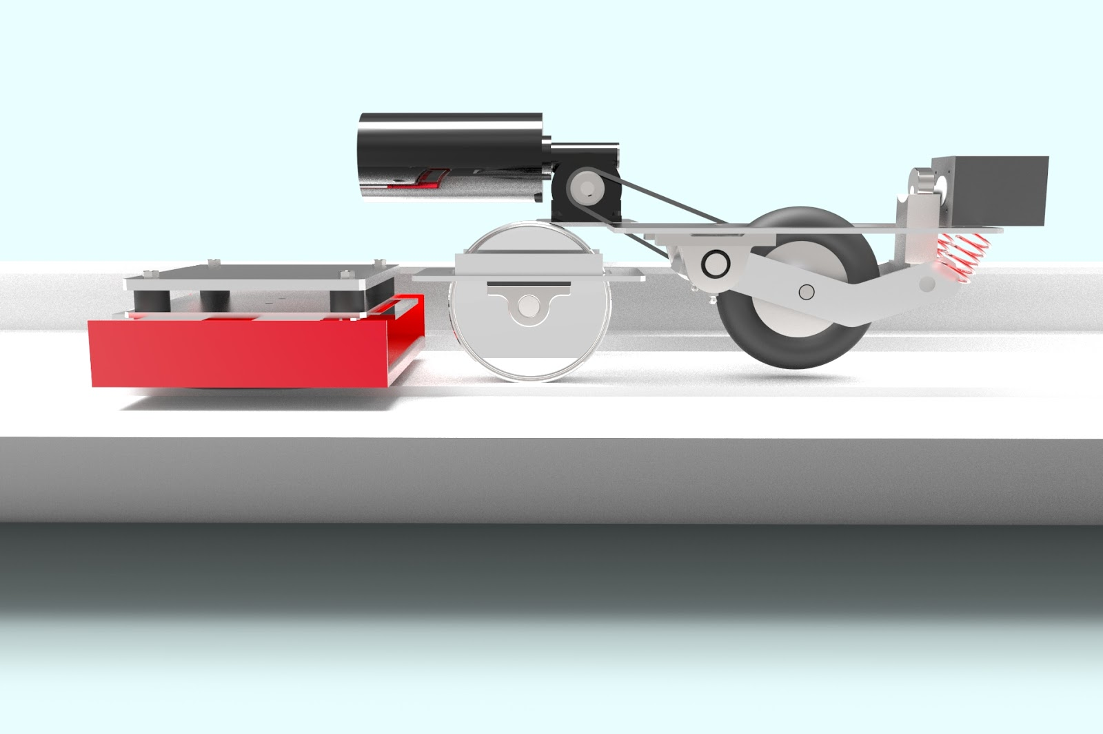
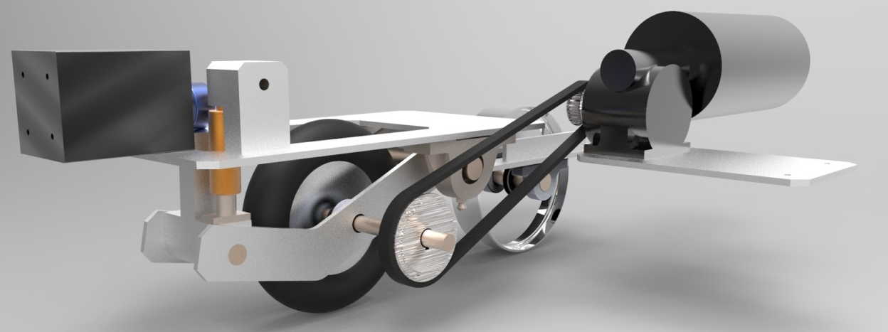
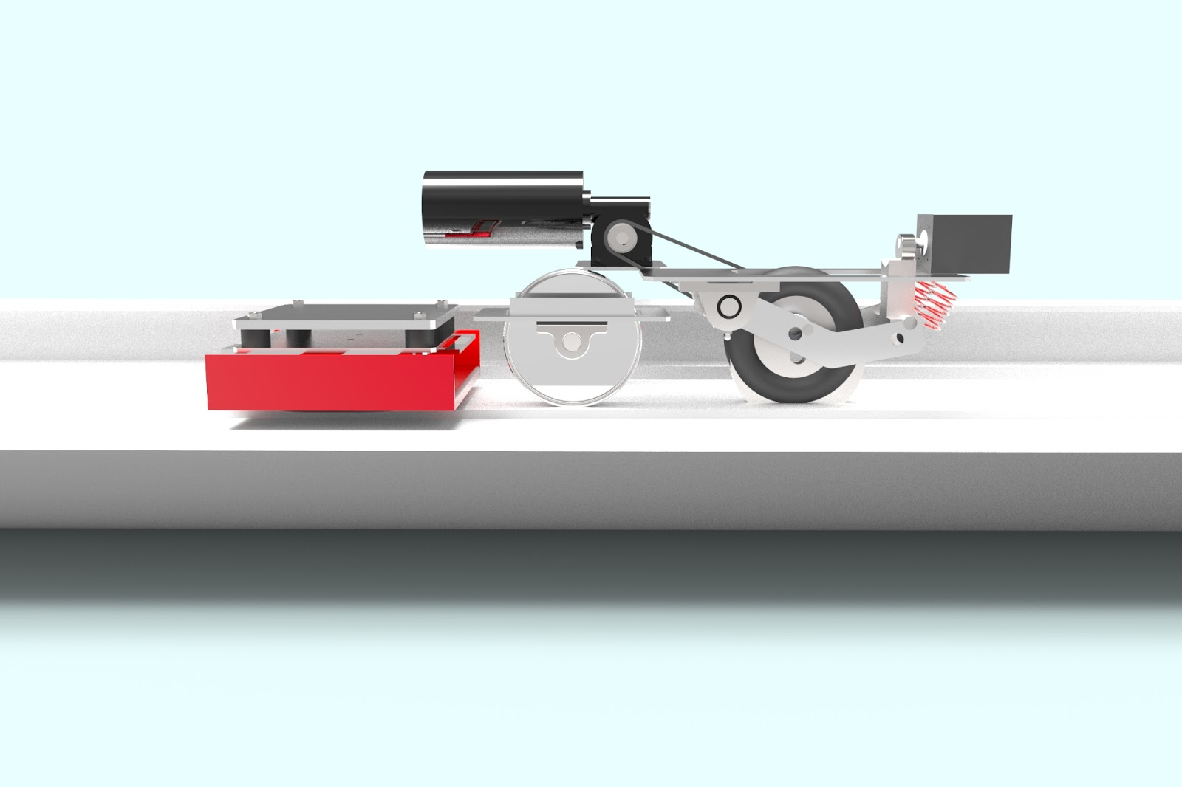
DRIVE TRAIN – POWER TRANSMISSION
Recovery Mode
Motor Specifications
Drive Mode
Max Speed | 2 m/s
Acceleration | 0.1 m/s^2
Wheel Radius | 0.1m
Torque | 7.62Nm
Power | 150W
University of Waterloo—Hyperloop Final Design Package | 23

Slide 24
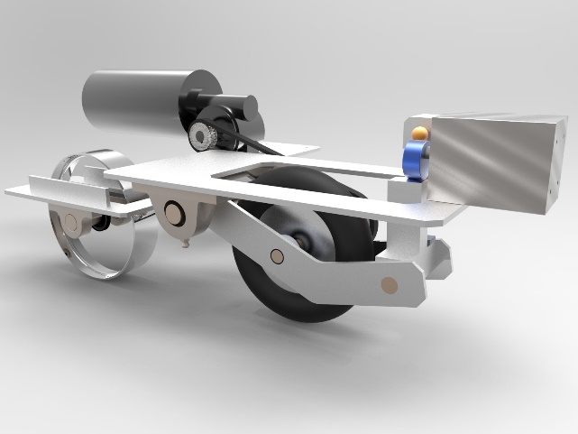
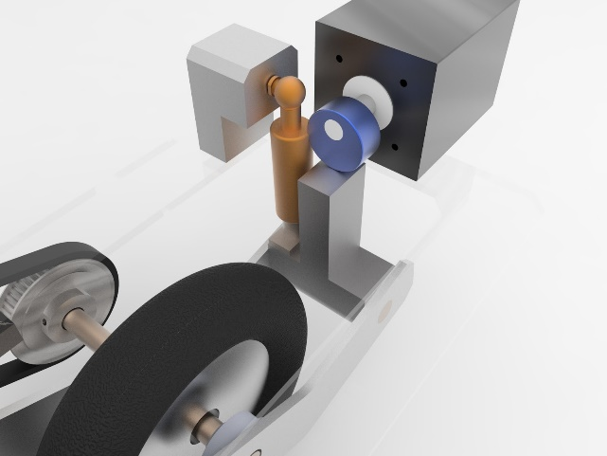
DRIVE TRAIN – CLUTCH
Clutch Design
Method of Actuation | 2 m/s
 | 0.1 m/s^2
Wheel Radius | 0.1m
Torque | 7.62Nm
Power | 150W
University of Waterloo—Hyperloop Final Design Package | 24

Slide 25
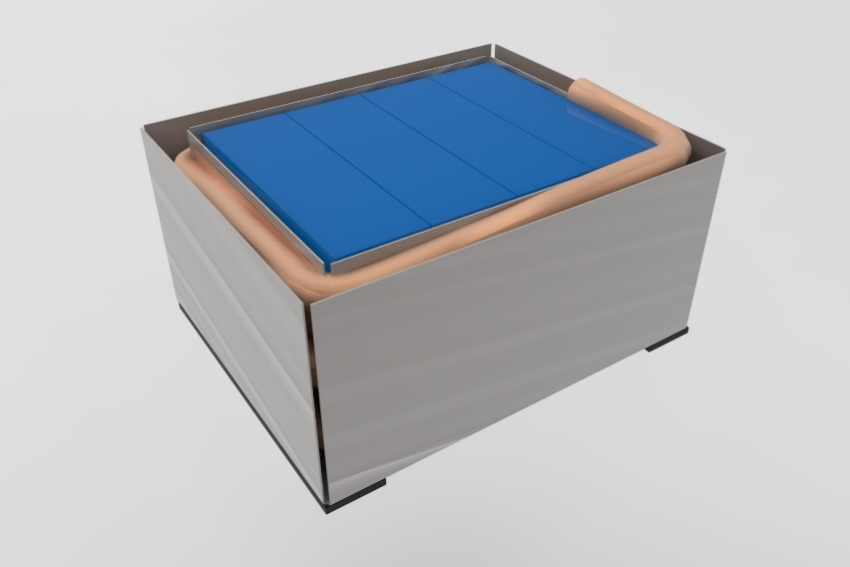
BATTERY - OUTLINE
Specs
4 x 24V Cells for Drive Motor
1 x 24V Cell for Clutch Actuator
15Ah per Cell (2C)
30A Max Current Draw
Energy density > power density for long servicing time
Testing Plans
Cycle testing
Overloading
Extreme Environment
Vibrations
University of Waterloo—Hyperloop Final Design Package | 25

Slide 26
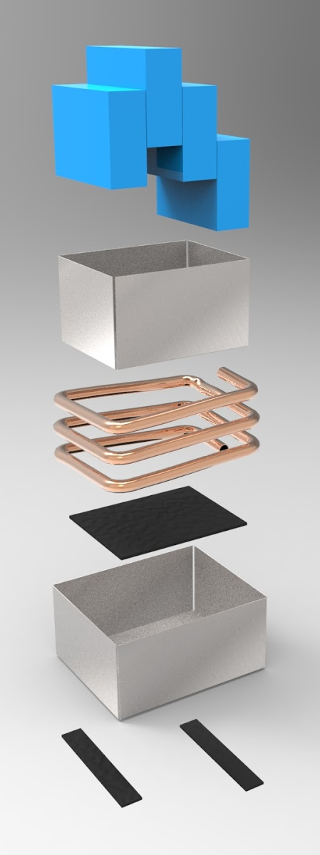
BATTERY - OUTLINE
Battery Cells
Inner Shell
Cooling Coil
Vibration
Dampening
Outer Shell
Specs
4 x 24V Cells for Drive Motor
1 x 24V Cell for Clutch Actuator
15Ah per Cell (2C)
30A Max Current Draw
Energy density > power density for long servicing time
Testing Plans
Cycle testing
Overloading
Extreme Environments
Vibrations
Show some THERMAL stuff from jake here
University of Waterloo—Hyperloop Final Design Package | 26

Slide 27
COMMUNICATION
Communication Notes
Using SpaceX recommended communication line
What will we communicate?
Camera feeds
polling sensor data
pinging to check communication line integrity
emergency stop
race start initiation
University of Waterloo—Hyperloop Final Design Package | 27

Slide 28
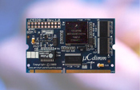
EMBEDDED SYSTEM/COMMUNICATION
Primary and Secondary Controller Board
Arcturus uC5328
uCLinux OS
Large support community
Self Monitoring
Each board monitors the other
Primary down → Secondary controlled stop
Arcturus uC5328
University of Waterloo—Hyperloop Final Design Package | 28

Slide 29
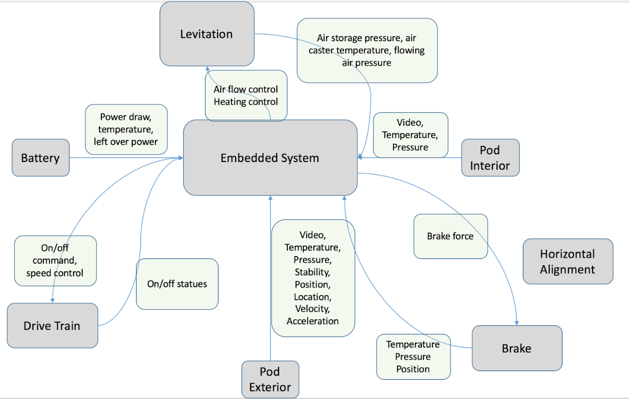
SENSORS
Sensor Considerations
Operating temperature range
Noise from physical vibrations
Sensor response time
University of Waterloo—Hyperloop Final Design Package | 29

Slide 30
SAFETY
Usman
Thermal Isolation
Vibration Dampening
Vacuum Protection
University of Waterloo—Hyperloop Final Design Package | 30

Slide 31
FMEA
Part | Failure Mode | Potential Cause | Probability (Estimate) | Severity | Detection | Risk Level
Frame | Catastrophic Failure | Excessive pusher load or severe impact | C | V | 5 | High
Brake Pads | Loss of braking ability | Cooling system malfunction resulting in brake pad degradation | A | V | 5 | High
Batteries | Explosion/fire | Overcharging | C | V | 5 | High
Air Casters | Friction underneath casters | Overloading air casters | B | I | 2 | Moderate
Brake Pad Mounting | Structural Failure | Excessive forces surpassing safety tolerances | A | V | 5 | Moderate
University of Waterloo—Hyperloop Final Design Package | 31

Slide 32
SAFETY MECHANISM FOR POWER LOSS
Battery System
Backup spare battery will take over system electronics immediately.
Levitation System
Main air supply will shut-off. Air casters will deflate to allow the pod to rest on idler wheels and prevent air caster damage.
Braking System
Vent valves will fail-open to actuate the brake system upon power loss or control signal loss
University of Waterloo—Hyperloop Final Design Package | 32

Slide 33
FAULT TOLERANCE OF CRITICAL SYSTEMS
Braking
2 sets of friction brakes (4 pads) to overcome mechanical failure
Eddy current brakes engaged simultaneously through integrated actuation
Primary and secondary controllers maintain brake system control at all times
Controls
Primary System – Main pod systems control
Secondary System – Monitoring and emergency protocol, maintains active signal for controlled braking
Primary Control System
Levitation Systems
Drivetrain System
System Failure
Battery Systems
Braking System (Failsafe)
Sensors and Actuators
Secondary Control System
Activate Emergency Protocols
University of Waterloo—Hyperloop Final Design Package | 33

Slide 34
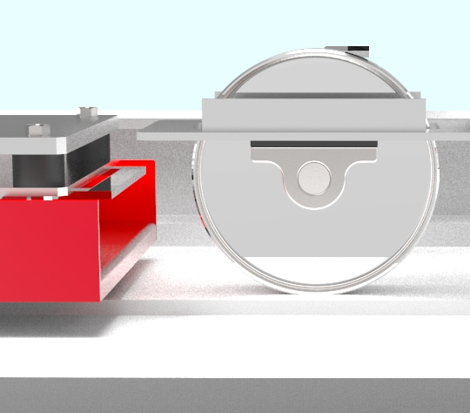


FAULT TOLERANCE OF CRITICAL SYSTEMS
Levitation
Pod weight shifts on to idler wheels in case of levitation system failure
Drivetrain
Mechanism itself is a fault tolerant procedure in case power, control, cooling or levitation system failure
Idler wheel
CAM Raised
Wheel Raised (gap)
CAM Lowered
Air Caster
Wheel in Contact (no gap)
University of Waterloo—Hyperloop Final Design Package | 34

Slide 35
SUBJECT FOR RE-DESIGN
method of lateral control
pod length
subtle shell mounting and contour shape
mounting of idler wheels
location of the pusher interface
University of Waterloo—Hyperloop Final Design Package | 35

Slide 36
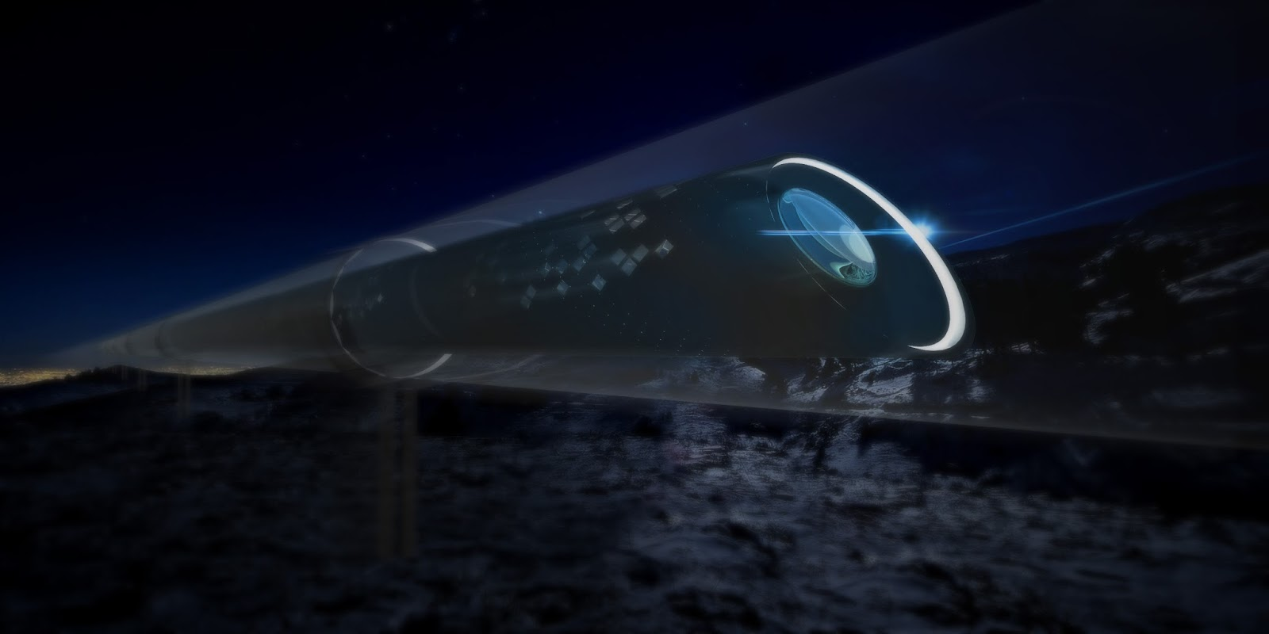
SCALABILITY
University of Waterloo—Hyperloop Final Design Package | 36

Slide 37
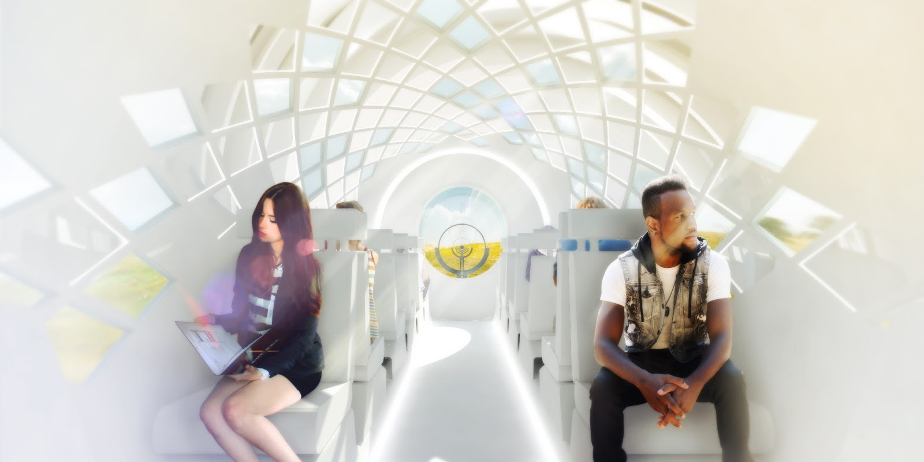
FULLSIZE SPECIFICATIONS
Capacity: 26 passengers per pod
Interior diameter: 2 meters
Top speed: ~1220 km/h
Cost: ~ $500,000 per pod
University of Waterloo—Hyperloop Final Design Package | 37

Slide 38
FULLSIZE SPECIFICATIONS
Modular Component
Easier to scale and maintain
Kantrowitz limit
Need to be considered
Linear induction motors
Will be used for operational acceleration and deceleration
Passenger ergonomics considerations
HVAC, entertainment, interior design etc
University of Waterloo—Hyperloop Final Design Package | 38

Slide 39
SPONSORSHIPS
Kik - Major sponsor
University of Waterloo (WEEF, Eng Soc)
Solidworks
Babylon VR
University of Waterloo—Hyperloop Final Design Package | 39

Slide 40
ADDITIONAL DOCUMENTS & SLIDES
University of Waterloo—Hyperloop Final Design Package | 40

